Slide 1


Final Task Project-Based Intern : Data Scientist ID/X Partners
Tsaniya Nur Sukma | 2023

Slide 2




HELLO!
I’m Tsaniya Nur Sukma
You can find me at :
tsaniyanurs00@gmail.com
https://www.linkedin.com/in/tsaniyans/
https://github.com/Tsaniyans
Tsaniya Nur Sukma | 2023

Slide 3
Table of Content
Business Understanding and Analytical Approach
3
Data Storytelling and Data Visualization
1
2
Exploration Data Analysis
4
Evaluation Modeling
Tsaniya Nur Sukma | 2023

Slide 4





Introduction
the project carried out is from a Lending Company where the data obtained is a Loan Dataset
Programming Language :
Python Libraries :
Tsaniya Nur Sukma | 2023

Slide 5
Business Understanding and Analytical Approach
Problem Statement
Business Metric
The lending company wants to develop a credit risk prediction model using a data set of customer loans by the company
- Accurancy
- Recall
- Precision
- F1 Score
1
Goals
Analytical Approach
Building credit risk predictions that can minimize unpaid credit risk and increase the efficiency of operational lending companies in assessing credit applications
Predictive Analytic
Tsaniya Nur Sukma | 2023

Slide 6
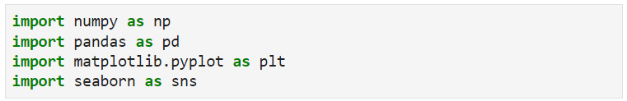

Exploration Data Analyst
Import data with the path of CSV.
besides the things here you can also use:
df_loan.describe().
To see if there is data that is null or NaN
Counts the number of occurrences of each value in a column.
Tsaniya Nur Sukma | 2023

Slide 7
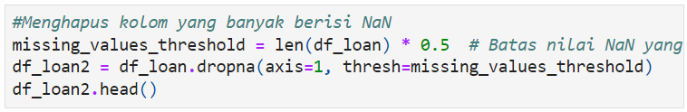
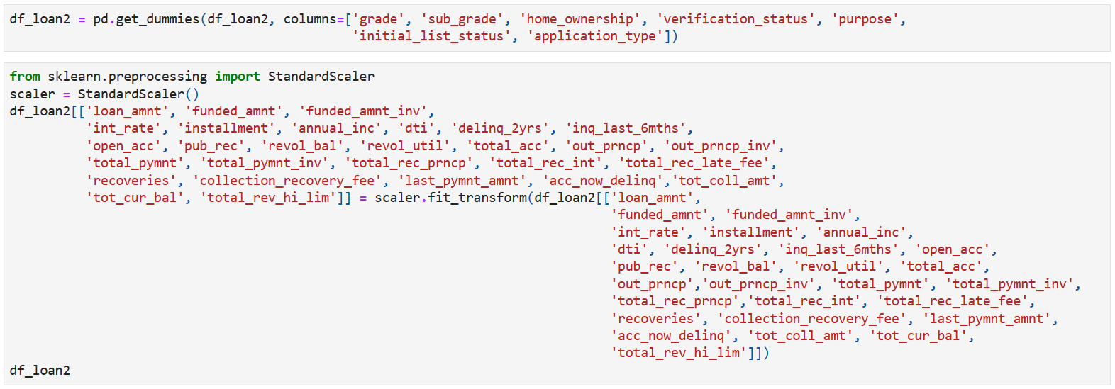
Data Pre-Processing
Returns column values ​​with median values
The result of the one-hot encoding process will be new columns that represent the unique values ​​of these categorical columns. The one-hot encoding process is useful for facilitating the analysis and processing of data in machine-learning models.
One-hot encoding
Tsaniya Nur Sukma | 2023

Slide 8
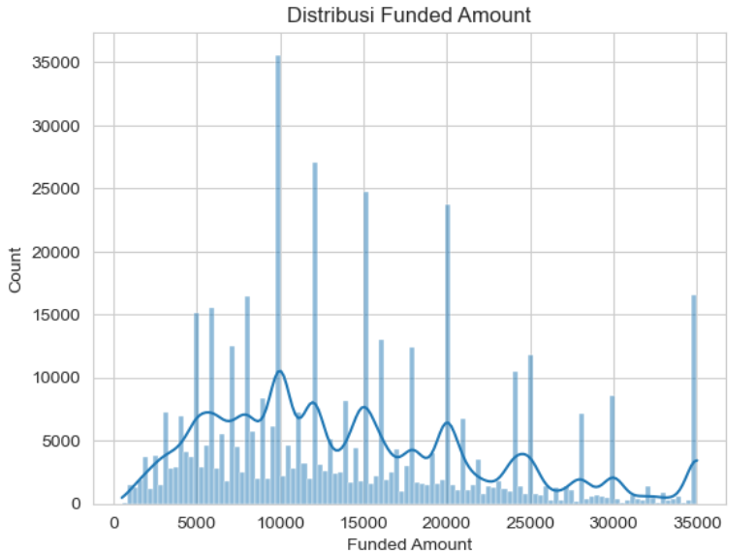
Data Storytelling and Data Visualization
1. The histogram in the "funded_amnt" column shows the distribution of the amount of funds provided to borrowers, where the majority of the amount of funds provided is in the range of 5000 to 20000.
Tsaniya Nur Sukma | 2023

Slide 9
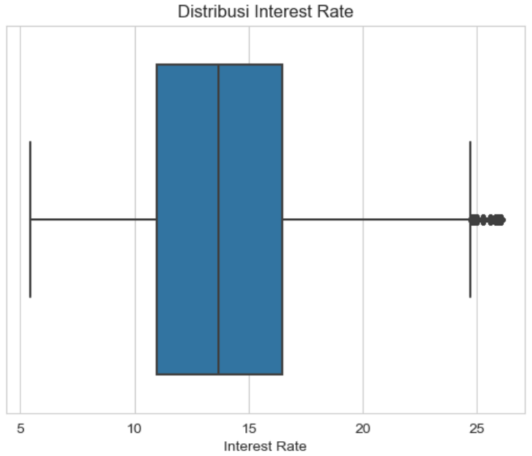
Data Storytelling and Data Visualization
2. The boxplot in the "int_rate" column shows the distribution of interest rates on loans, where most interest rates are in the range of 10 to 16 percent and there are some outliers above 20 percent.
Tsaniya Nur Sukma | 2023

Slide 10
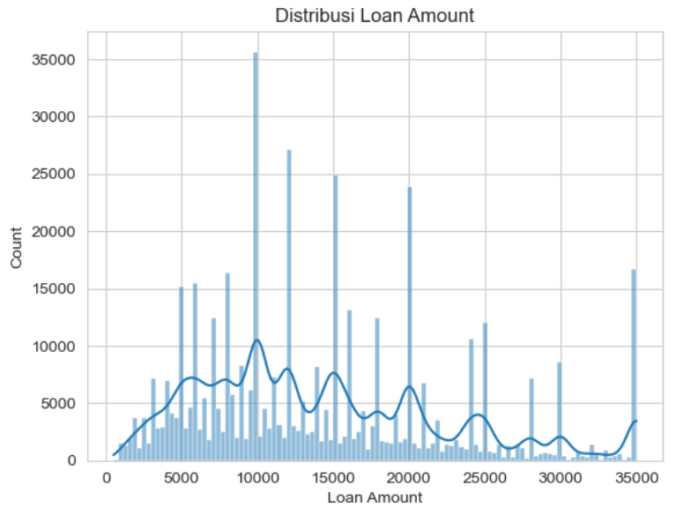
Data Storytelling and Data Visualization
3. The histogram in the "loan_amnt" column shows the distribution of the number of loans granted, where the majority of loan amounts are in the range of 5000 to 20000.
Tsaniya Nur Sukma | 2023

Slide 11
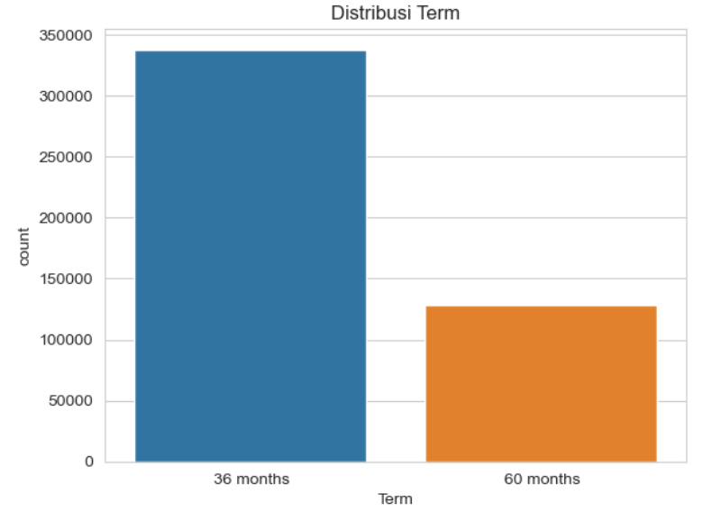
Data Storytelling and Data Visualization
4. The countplot in the "term" column shows the distribution of loan terms, where the majority of borrowers choose a term of 36 months (3 years).
Tsaniya Nur Sukma | 2023

Slide 12
The distribution of each of these columns can provide important information for data scientists in making credit risk prediction models, such as estimating the probability of default on a loan or predicting the number of loans to be approved.
Tsaniya Nur Sukma | 2023

Slide 13
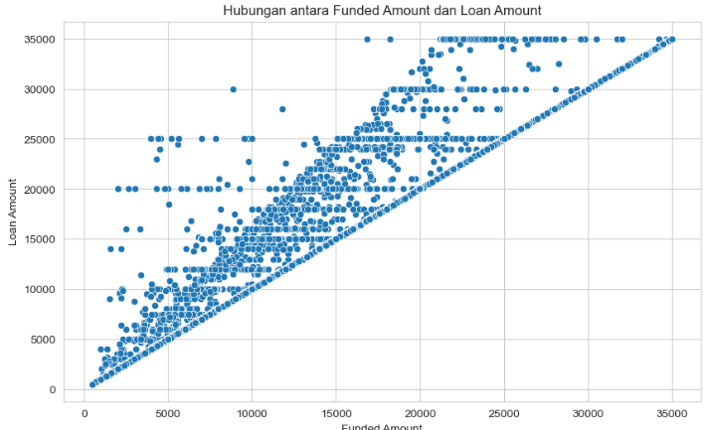
Data Storytelling and Data Visualization
It can be seen that most of the data is in a diagonal line which indicates that the amount of loan requested is almost the same as the amount of funds provided. However, there is also some data located below this diagonal line, indicating that the borrower may not obtain all the loans requested. In addition, there is also some data located above this diagonal line, which indicates that the borrower may borrow more than the amount proposed. The plot gives a good idea of ​​how funds and loans relate to each other in the dataset.
Tsaniya Nur Sukma | 2023

Slide 14
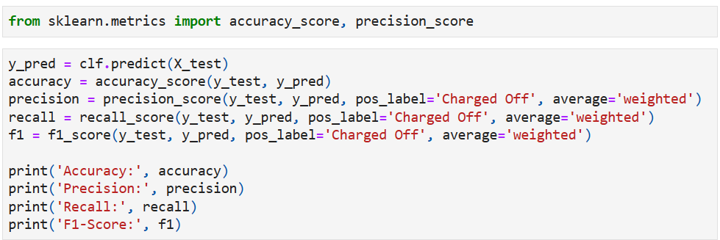
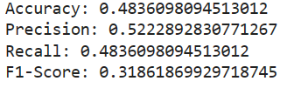
Algorithm Model
The algorithm used in making a credit risk prediction model is Logistic Regression
Input and Processing
Output
Tsaniya Nur Sukma | 2023

Slide 15
Algorithm Model
From the results above, the accuracy, precision, recall, and F1-score values ​​of the classification model that has been made based on business metrics show how well the model performs in predicting the target label from the test data, where the greater these values, the better the model's performance. .
In that case, an accuracy value of 0.48 indicates that the model has a low level of accuracy in predicting the target label from the test data. Meanwhile, the precision, recall, and F1-score values ​​show the model's performance in the 'Charged Off' class, where the precision value of 0.52 indicates that of all the predictions for the 'Charged Off' class, around 52% of the predictions actually belong to the 'Charged Off' class. Charged Off'. Meanwhile, the recall value of 0.48 indicates that of all 'Charged Off' class data, only about 48% of the data was correctly predicted by the model. The low F1-score value of 0.31 indicates that the model's performance in predicting the 'Charged Off' class still needs to be improved.
Tsaniya Nur Sukma | 2023

Slide 16
THANK YOU
Tsaniya Nur Sukma | 2023

Slide 17
External Source
https://towardsdatascience.com/credit-risk-analysis-with-machine-learning-736e87e95996
https://shs.hal.science/halshs-01835164/document
https://www.kaggle.com/code/zhaoyunma/credit-risk-prediction
https://towardsdatascience.com/credit-risk-modeling-with-machine-learning-8c8a2657b4c4
Tsaniya Nur Sukma | 2023

